Slide 1
IT 1107 Mathematics for IT
Week 9 - Matrix Multiplication & Determinant

Slide 2
Matrix multiplication
A rxn matrix A can be multiplied by a nxc matrix B and the resulting matrix is a rxc matrix which is denoted by AB
i.e. the resulting matrix has the same number of rows as the first matrix & same number of columns as the 2nd matrix
Note: to multiply two matrices number of columns of the 1st matrix must be equal to the number of rows of the 2nd matrix

Slide 3
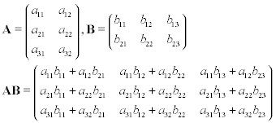

Slide 4
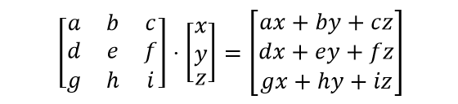
Multiplying a matrix by a vector

Slide 5
Properties of matrix multiplication
when a matrix is multiplied by the identity matrix, the product is the same as the original matrix
MI = IM = M
Matrix multiplication is not commutative
AB ≠ BA
Matrix multiplication is associative
A(BC)=(AB)C

Slide 6
Matrix multiplication is associative when it is being multiplied by a scalar
(kA)B = k(AB) = A(kB)
Matrix multiplication is distributive
A(B+C) = AB + AC
Transposing the product of two matrices is as same as taking the product of their transposes in the reverse order
(AB)^{T} = B^{T} A^{T}

Slide 7

Multiplying a vector & a matrix
$\left[\begin{matrix}x & y & z\end{matrix}\right]\left[\begin{matrix}m11 & m12 & m13 \\ m21 & m22 & m23 \\ m31 & m32 & m33\end{matrix}\right]=$
$$\left[\begin{matrix}xm11+ym21+zm31 & xm12+ym22+zm32 & xm13+ym23+zm33\end{matrix}\right]$$
$\left[\begin{matrix}m11 & m12 & m13 \\ m21 & m22 & m23 \\ m31 & m32 & m33\end{matrix}\right]\left[\begin{matrix}x & y & z\end{matrix}\right]$ = undefined

Slide 8
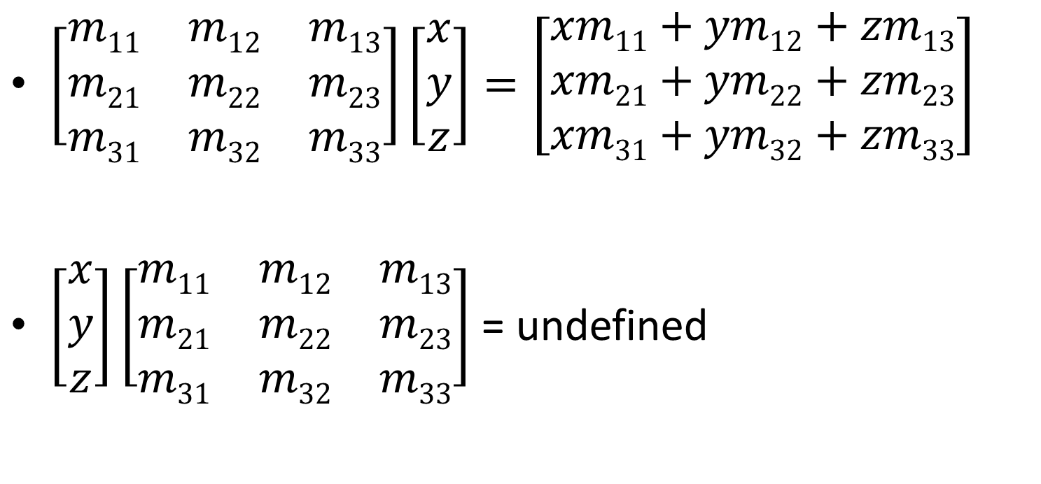
$\left[\begin{matrix}m11 & m12 & m13 \\ m21 & m22 & m23 \\ m31 & m32 & m33\end{matrix}\right]\left[\begin{matrix}x \\ y \\ z\end{matrix}\right]=\left[\begin{matrix}xm11+ym12+zm13 \\ xm21+ym22+zm23 \\ xm31+ym32+zm33\end{matrix}\right]$
$\left[\begin{matrix}x \\ y \\ z\end{matrix}\right]\left[\begin{matrix}m11 & m12 & m13 \\ m21 & m22 & m23 \\ m31 & m32 & m33\end{matrix}\right]$ = undefined

Slide 9
Determinant of a matrix
A determinant is a real number associated with every square matrix.
Determinant tell us whether or not a matrix can be inverted
The determinant of A is written as |A| or det A

Slide 10

Calculating determinant for a 2x2 matrix
If A = $\left[\begin{matrix}a & b \\ c & d\end{matrix}\right]$ then
|A| = $\left|\begin{matrix}a & b \\ c & d\end{matrix}\right|$
= ad-bc

Slide 11
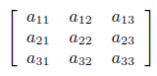

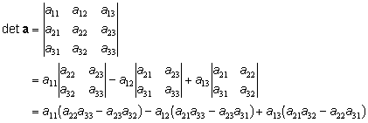
Calculating determinant for a 3x3 matrix
If A = then
+
-
+

Slide 12
Properties of determinants
If two rows or columns are equal then det A =0
det A = det A^{T}
If a row(or column) of A consists entirely of 0 then det(A)=0
det(AB) = det A.det B = det(BA)
Note: if det A=0 then the matrix don’t have an inverse

